Slide 1
Basic terms and concepts of statistics
February 2016

Slide 2
content
Population parameters
Sample
Sample statistics
Descriptive and Inferential statistics
Inappropriate data collection methods
How to ensure that sample statistic represent population parameters?

Slide 3
Population parameters
Population is an entire collection of objects which a study is interested in.
The objects can be people, animals etc.
The population size can be very large (billions) to very small (for example 50).
A study that involves the population is called a census.
Data collection involves certain characteristics of the data such as weight in Kg.
Summaries of population data are called parameters, (for example; Population size denoted by N, Population mean denoted by µ (mu), Population variance denoted by σ² and Population standard deviation denoted by σ).
There is only one values for each population parameter and is usually estimated.

Slide 4
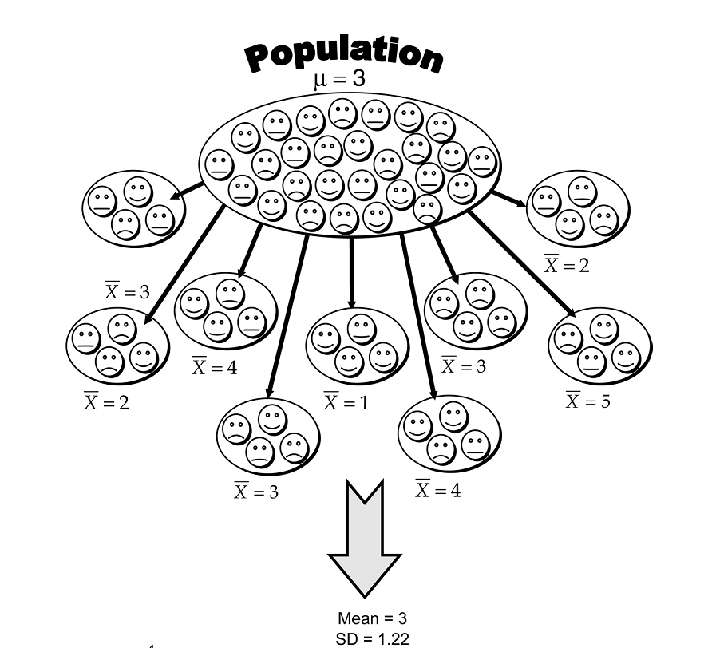
Sample
Sample is a sub-set of population drawn from the population of interest.
The sample size is denoted by n
Sample size is smaller than population size N
It is important to determine the sample size n before drawing the sample from the population of interest.

Slide 5
Sample statistics
The summaries of population data is called parameters while the summaries of sample data are called statistics.
Sample is a sub-set of population drawn from the population of interest.
The sample size is denoted by n (for example; sample size denoted by n, sample mean is denoted by x (x bar), sample variance denoted by S² and sample standard deviation denoted by s (known as standard error).
Many different samples can be drawn from a population and different samples give different sample statistics.

Slide 6
Descriptive vs Inferential statistics
Descriptive statistics
Summarizes the data in terms of center point, dispersion, and distribution.
Central tendency: Locating the centre point (mean, mode, median)
Dispersion: The spread in terms of smallest values to the largest (variability).
Distribution: the spread of the data in terms of symmetry, skewed, peaked, flat, etc.
Inferential statistics
Estimate population parameters.
Compare significant difference between two or more population.
Tests for relationship between variables to make prediction.

Slide 7
How to believe that sample statistics can make inferences about population parameters?
Sample can be representative for a population and sample statistics can be used in making inferences about population parameters if the data are NOT:
manipulated data for a personal gain (intentionally)
inappropriate data collection method is used, using poor questionnaires, biased samples or not representative samples (unintentionally)

Slide 8
In appropriate data collection methods?
How many practice good personal hygiene? (Research question):
Can I see your hand to check how many of you wash your hand after going to toilet? (bad question for asking people: inappropriate data collection method).
How to collect such kind of data?: Use anonymous survey or observation.
Unemployment of youth is increasing, do you think the government is doing enough to help young people get jobs? (Poor question because it prompts the respondents in a particular way hence the responses obtained will be biased).
What to do? (Rephrase the questions as: “Tell me about your opinion what the government has done to help unemployed youth to get employed”?)

Slide 9
-Non-representative or biased sample
What do Bhutanese people think about the difficulties of animal and crop farming in rural areas? (Research question).
Student goes to Thimphu and collects data asking civil servants and not farmers (non-representative and biased sample).
What do Bhutanese people think about advantages and disadvantages of internet speed in Bhutan?
Student uses online questionnaires and draws conclusion based on the responses received (Biased sample as all Bhutanese may not have access to respond to online survey;
All who received questionnaires may not respond and may not represent particular place or a community)
Beware: about those people who manipulate data intentionally.
Can be improved who collects data using inappropriate methods.

Slide 10
How to make sure that sample statistics is a good representative for a population parameters?
Draw sample carefully (selecting randomly considering the all possible variation).
Draw appropriate sample size (usually large sample size reduces variability).

Slide 11
What statistical tools cannot do?
Choosing good sample
Choosing good variables
Measuring variables precisely

